Slide 1
Simulation & Modeling 2019-2020
LAB 5

Slide 2
Inventory Problems
THE NEWSPAPER SELLER

Slide 3


The Newspaper Seller’s Problem
33 cents
50 cents
70
17 cents
5 cents

Slide 4
The Newspaper Seller’s Problem
10
90
70
100
40

Slide 5
The Newspaper Seller’s Problem
Good days
Fair days
Poor days

Slide 6
The Newspaper Seller’s Problem
A classical inventory problem concerns the purchase and sale of newspapers.
The paper seller buys the papers for 33 cents each and sells them for 50 cents each.
Newspapers not sold at the end of the day are sold as scrap for 5 cents each.
Newspapers can be purchased in bundles of 10. Thus, the paper seller can buy 50, 60, and so on.
There are three types of newsdays, “good,” “fair,” and “poor”. Each having its own probability.
The problem is to determine the optimal number of papers the newspaper seller should purchase.
This will be accomplished by simulating demands for 20 days and recording profits from sales each day

Slide 7
The Newspaper Seller’s Problem
There are three types of newsdays, “good,” “fair,” and “poor”. Each having its own probability.
The problem is to determine the optimal number of papers the newspaper seller should purchase.
This will be accomplished by simulating demands for 20 days and recording profits from sales each day

Slide 8
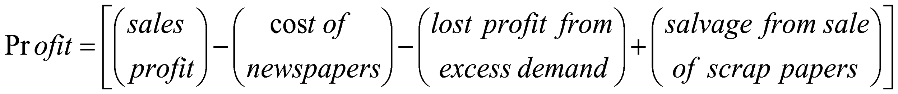
The Newspaper Seller’s Problem
The profits are given by the following relationship:

Slide 9
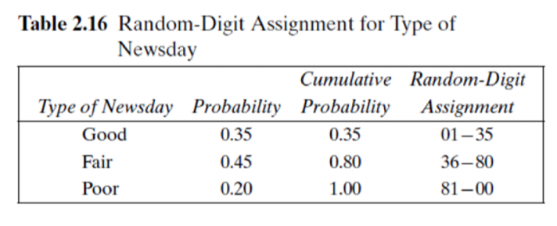
The Newspaper Seller’s Problem

Slide 10
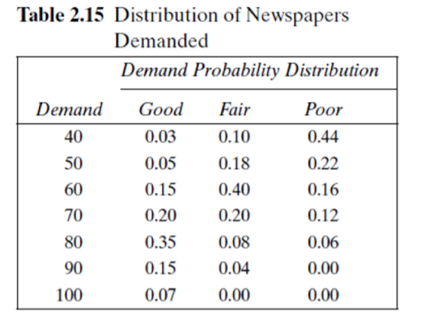
The Newspaper Seller’s Problem

Slide 11
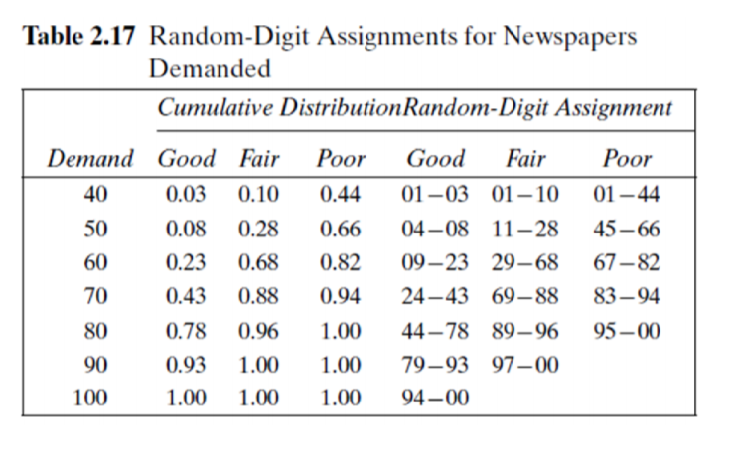
The Newspaper Seller’s Problem

Slide 12
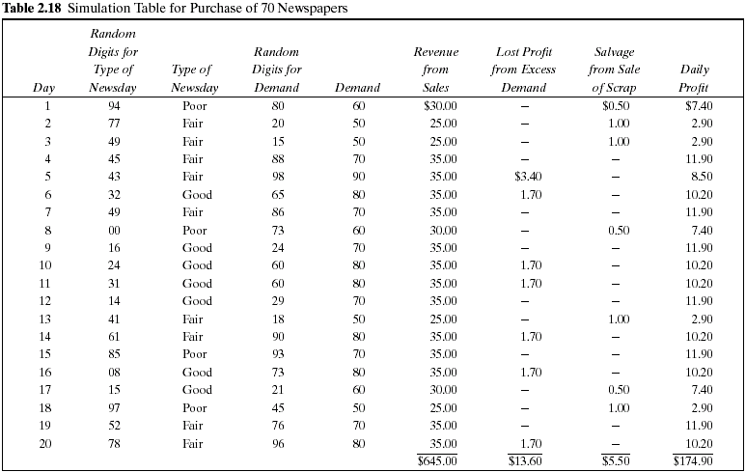
On day 1 the demand is for 60 newspapers.
The revenue from the sale of 60 newspapers is $30.00.
Ten newspapers are left over at the end of the day. The salvage value at 5 cents each is 50 cents
• The profit for the first day is determined as follows: Profit = $30,00 − $23,10 − 0 + $50 = $7,40
Cost = 70 * 33 = 2310 cents = 23.1$

Slide 13
The Newspaper Seller’s Problem
The profit for the 20-day period is the sum of the daily profits, $174.90. It can also be computed from the totals for the 20 days of the simulation as follows:
Total profit = $645.00 - $462.00 - $13.60 + $5.50 = $174.90
The policy (number of newspapers purchased) is changed to other values and the simulation repeated until the best value is found.

Slide 14
The Newspaper Seller’s Problem
Example: Demand = 90
70 * 0.33 = 23.1$ [cost of buying 70 newspapers ]
70 * 0.5 = 35$ [Revenue of selling 70 newspapers]
20 * (0.5-0.33) = 20*.17 = 3.4$ [Lost Profit of the 20 newspapers]
Total profit = 35 – 23.1 – 3.4

Slide 15
The Newspaper Seller’s Problem
Example: Demand = 60
70 * 0.33 = 23.1$ [Cost of buying 70 Newspapers]
60 * 0.5 = 30$ [Revenue of selling 60 newspapers]
10 * 0.05 = 0.5 [Scrap Salvage of the remaining 10 newspapers]
Total profit = 30 – 23.1 + 0.5

Slide 16
System Input
Newspaper Purchase Price
Newspaper Selling Price
Newspaper Scrap Value
Number of Papers Purchased by News Dealer
Probability distribution of the predefined news day types (Good, Fair, Poor)
The demand probability distribution for each day type

Slide 17
System Output
1. Simulation table with the columns below:
Day index
random number for day type
day type
random number for demand
demand (based on day type)
revenue from sales
lost profit from excess demand
salvage from sale of scrap
daily profit

Slide 18
System Output
2. Performance measures:
Total Sales Revenue
Total Cost of Newspapers
Total Lost Profit from Excess Demand
Total Salvage from sale of Scrap papers
Net Profit
Number of days having excess demand
Number of days having unsold papers

Slide 19
Task (2) Deliverables
The complete simulation table for N Days for example 20 days (refer to slide 17)
The performance metrics calculated from the simulation table (refer to slide 18)
READ from a file (TestCases) is a mandatory.

Slide 20
Task (2) Delivery Rules
Task delivery next week (starting from 2.11.2019 till 5.11.2019)
Every team should commit to their assigned time slot [same as Task(1)]
Any delay will not be accepted
Task should be uploaded on Friday 11:59 pm for Saturday’s delivery schedule.
Task should be uploaded on Monday 11:59 pm for Tuesday’s delivery schedule.
If you didn’t upload your full project (not compressed and not renamed) before deadline, you’ll get zero for this task.
Cheating Policy
First Incident: -10% from the yearwork grades
Second Incident: -50% from the yearwork grades
Third Incident: -100% from the yearwork grades
Notes:
Task delivery time will be sent

Slide 21
More Notes
GUI is mandatory.
Well OOP design is mandatory (Don’t put all your code in events!).

Slide 22
Template Walkthrough

Slide 23
The Newspaper Seller’s Problem
Good days
Fair days
Poor days

Slide 24
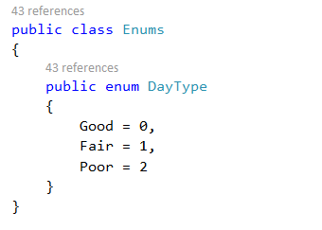

Slide 25
The Newspaper Seller’s Problem

Slide 26
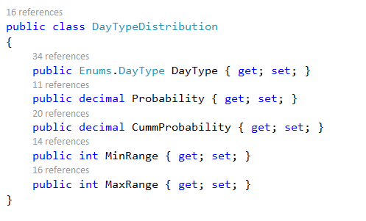

Slide 27
The Newspaper Seller’s Problem

Slide 28
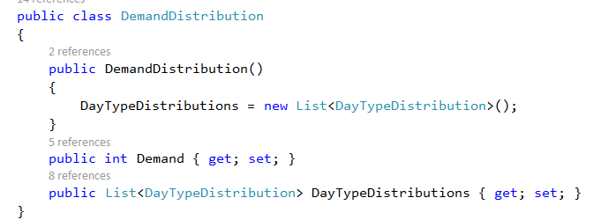

Slide 29
Cost = 70 * 33 = 2310 cents = 23.1$

Slide 30
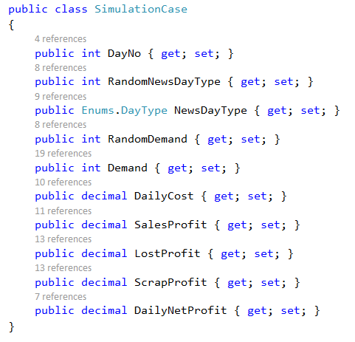

Slide 31
System Output
2. Performance measures:
Total Sales Revenue
Total Cost of Newspapers
Total Lost Profit from Excess Demand
Total Salvage from sale of Scrap papers
Net Profit
Number of days having excess demand
Number of days having unsold papers

Slide 32
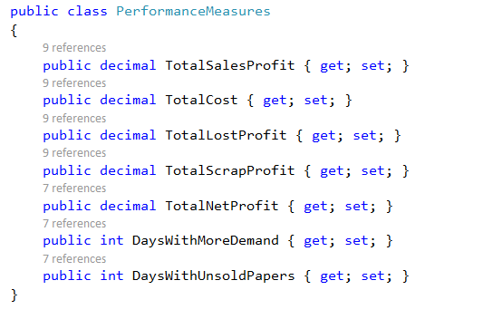

Slide 33
System Input
Newspaper Purchase Price
Newspaper Selling Price
Newspaper Scrap Value
Number of Papers Purchased by News Dealer
Probability distribution of the predefined news day types (Good, Fair, Poor)
The demand probability distribution for each day type

Slide 34
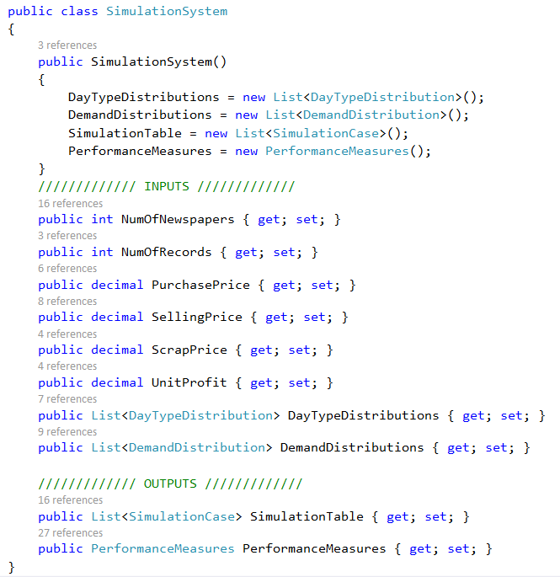

Slide 35
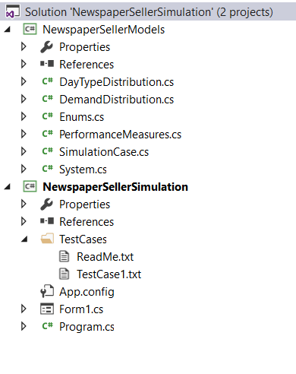

Slide 36
Using TestCases
You are given a testcase to run that will provide with a message
Success message if your code runs correctly.
Error message describing the failed part.
Running using testcases
Your system object

Slide 37
Thank You…

